Slide 1
PHP Arrays and User Defined Functions
ITWA133

Slide 2
PHP Arrays and User Defined Functions
Objectives
To know the different approach of using arrays in PHP.
To be familiar with using print_r function and var_dump function for array inspection.
To use PHP lazy function foreach to iterate through array elements.
To implement one dimensional and multi-dimensional in the program.
To know what is associative array in PHP.
To use different predefined functions in manipulating array elements.
To defined what is function and to use function keyword in declaring function in PHP.
To create a user defined function using different approach.

Slide 3
PHP Arrays and User Defined Functions
Objectives (continue)
To know use variables that is globally declared and locally declared.
To create static variables that can be used in accumulating data every time the function calls.

Slide 4
PHP Arrays

Slide 5
PHP Arrays and User Defined Functions
Array
is used to aggregate a series of similar items together, arranging and dereferencing them in some specific way.
Each member of the array index references a corresponding value and can be a simple numerical reference to the value’s position in the series, or it could have some direct correlation to the value.
PHP array does not need to declare how many elements that the array variable have.
Array index in PHP can be also called as array keys.
Array can be used as ordinary array same as in C and C++ arrays.

Slide 6
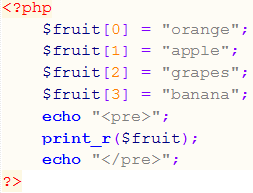
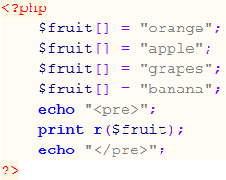
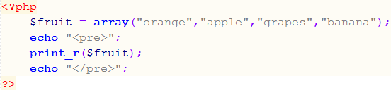
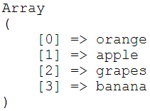
PHP Arrays and User Defined Functions
Array: one dimensional
Example: Code 1
Example: Code 2
Example: Code 3
Output:

Slide 7
PHP Arrays and User Defined Functions
Array: Functions for visualizing arrays
print_r() function
short for print recursive. This takes an argument of any type and prints it out, which includes printing all its parts recursively.
var_dump() function
is same as the print_r function except that it prints additional information about the size and type of the values it discovers
print_r() and var_dump() functions are commonly used for debugging. The point of this of these functions is to help you visualize what’s going on with compound data structures like arrays.

Slide 8
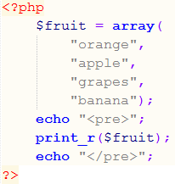
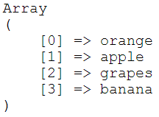
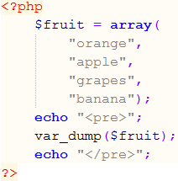
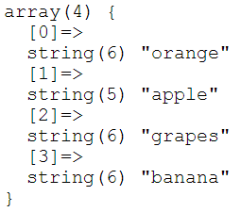
PHP Arrays and User Defined Functions
Array: Functions for visualizing arrays
Example: using print_r()
Output:
Example: using var_dump()
Output:

Slide 9
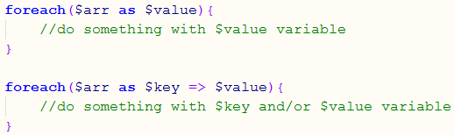
PHP Arrays and User Defined Functions
Array: Looping through array elements
foreach() function
is a statement used to iterate or loop through the element in an array. With each loop, a foreach statement moves to the next element in an array.
foreach statement
specify an array expression within a set of parenthesis following the foreach keyword.
Syntax

Slide 10
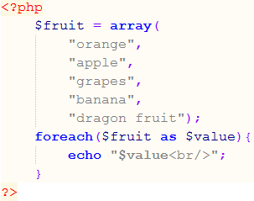
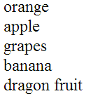
PHP Arrays and User Defined Functions
Array: Looping through array elements
$arr The name of the array that you’re walking through.
$key The name of the variable where you want to store the key. (optional)
$value The name of the variable where you want to store the value
Example:
Output:

Slide 11
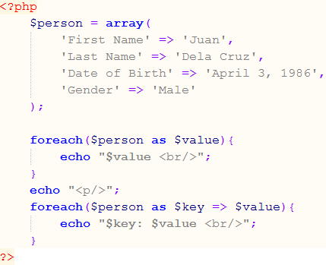
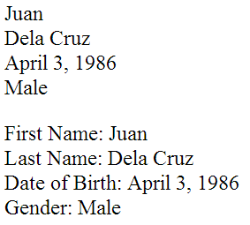
PHP Arrays and User Defined Functions
Array: Looping through array elements
Example:
Output:

Slide 12
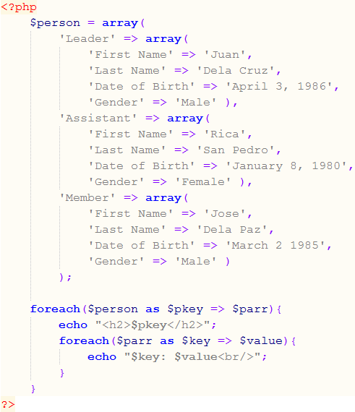
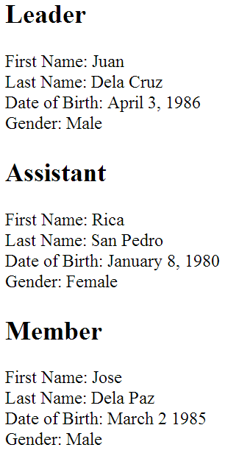
PHP Arrays and User Defined Functions
Arrays: Multidimensional arrays
Output:
Example:

Slide 13
PHP Arrays and User Defined Functions
Arrays: Sorting
Function | Description
sort($array) | Sorts by value; assign new numbers as the keys
rsort($array) | Sorts by value in reverse order; assign new number as the keys
asort($array) | Sorts by value; keeps the same key
arsort($array) | Sorts by value in reverse order; keeps the same key
ksort($array) | Sorts by key
krsort($array) | Sorts by key in reverse order
usort($array, functionname) | Sorts by a function

Slide 14
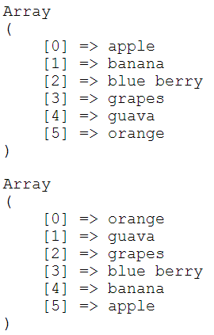
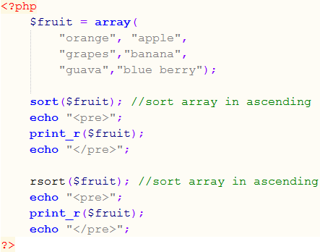
PHP Arrays and User Defined Functions
Arrays: Sorting
Example:
Output:

Slide 15
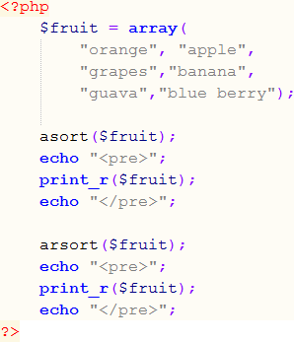
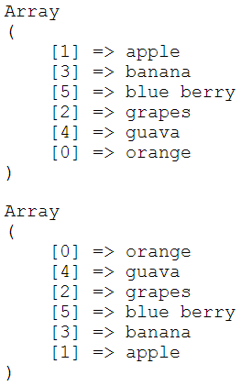
PHP Arrays and User Defined Functions
Arrays: Sorting
Example:
Output:

Slide 16
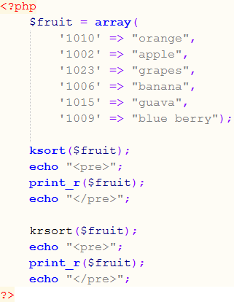
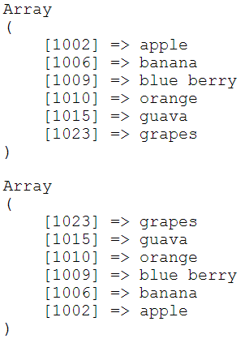
PHP Arrays and User Defined Functions
Arrays: Sorting
Example:
Output:

Slide 17
PHP User Defined Functions

Slide 18
PHP Arrays and User Defined Functions
Functions
is a group of PHP statements that performs a specific task. Functions are designed to allow you to reuse the same code in different locations.
User defined functions
functions that are provided by the user of the program.
Predefined functions
functions that are built-in into PHP to perform some standard operations

Slide 19
PHP Arrays and User Defined Functions
Functions: User defined functions
Syntax
function name(param){
//code to be executed by the function
}
Where
function – is the keyword used to declare a function
name – is the name of the function or function identifier
param – is the formal parameters of the function. Parameter must follow the rule of naming dentifier.

Slide 20
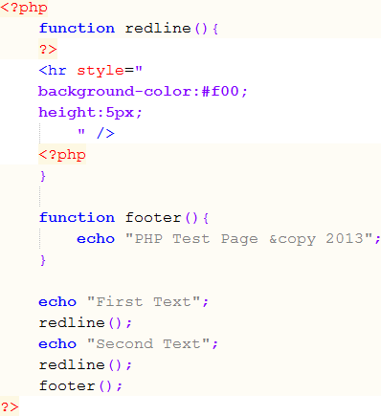
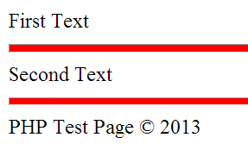
PHP Arrays and User Defined Functions
Functions: Function with no parameters
Example:
Output:

Slide 21
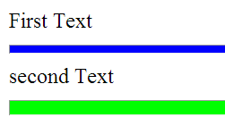
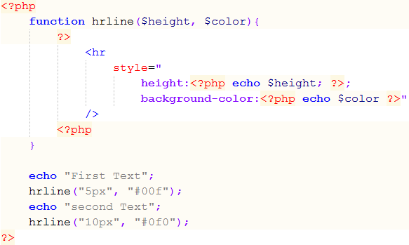
PHP Arrays and User Defined Functions
Functions: Function with parameters
Example:
Output:

Slide 22
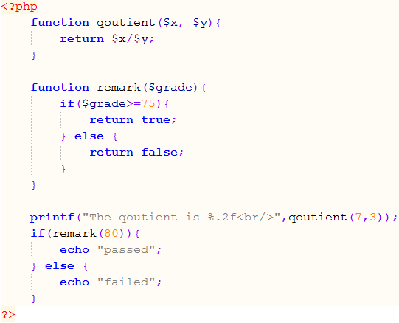

PHP Arrays and User Defined Functions
Functions: Function that returns a value
Example:
Output:

Slide 23
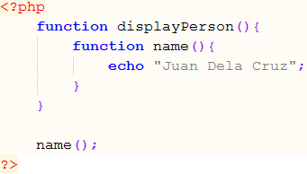

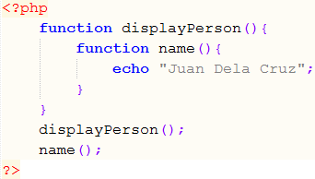
PHP Arrays and User Defined Functions
Functions: Nested function
Example:
Output:
Example:
Output:

Slide 24
PHP Arrays and User Defined Functions
Functions: Variable scope
Global Variables
is one that declared outside a function and is available to all parts of the program.
Local Variables
is declared inside a function and is only available within the function in which it is declared.
Static Variables
is used to retain the values calls to the same function.

Slide 25
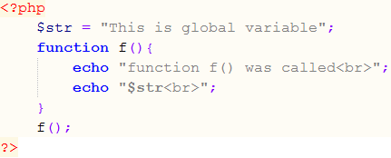

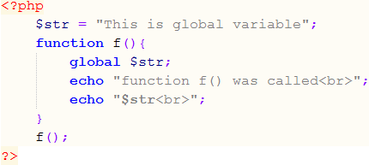

PHP Arrays and User Defined Functions
Functions: using variables
Example:
Output:
Example:
Output:

Slide 26
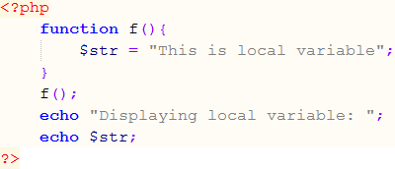

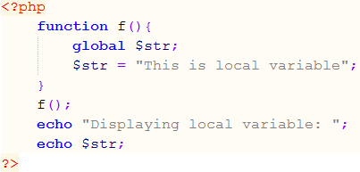
PHP Arrays and User Defined Functions
Functions: using variables
Example:
Output:
Example:
Output:

Slide 27
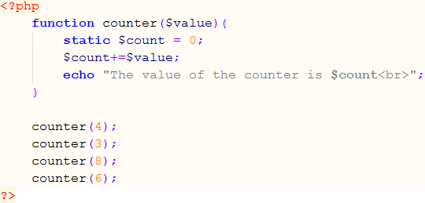

PHP Arrays and User Defined Functions
Functions: using variables
Example:
Output:

Slide 28
An introduction to PHP web programming
Summary
Array is used to aggregate a series of similar items together.
Array index references a corresponding value.
Array index can be simple numerical or have some direct correlation to the value.
Array index is also known as Array Keys.
print_r function is used to print the array structure.
var_dump function is same as print_r function except it adds additional information about the data of each element.
The foreach statement is use to iterate through the element in an array.
Using foreach statement you can display both the keys and value of each element in the array.
PHP provides functions for array manipulation such as sort(), rsort(), asort(), arsort(), ksort(), krsort(), and usort() functions.

Slide 29
An introduction to PHP web programming
Summary (continue)
sort(), asort(), and ksort() functions are used to sort elements in the array in ascending order.
rsort(), arsort(), and krsort() functions are used to sort elements in the array in descending order.
sort() and rsort() does not maintain its index reference for each values.
asort(), ksort(), arsort(), and krsort() maintains its reference for each values.
asort() and arsort() used to sort elements by values.
ksort() and krsort() used to sort elements by keys.
Functions is a group of PHP statements that performs a specific task.
Functions can be user defined generally defined by the user of the program and predefined that are build in using libraries.

Slide 30
An introduction to PHP web programming
Summary (continue)
You use functions in different ways. Function can only do something without passing values. You can pass values to a function and you can ask functions to return a value.
function keyword is used in PHP to declare a function.
A function that is declared inside a function is said to be hidden.
To gain access to a variable that is outside from the function we use the global keyword.
We use static keyword to declare a variable inside a function that will act as accumulator variable this will let the program remember the last value of the variable that was used.

